Slide 1
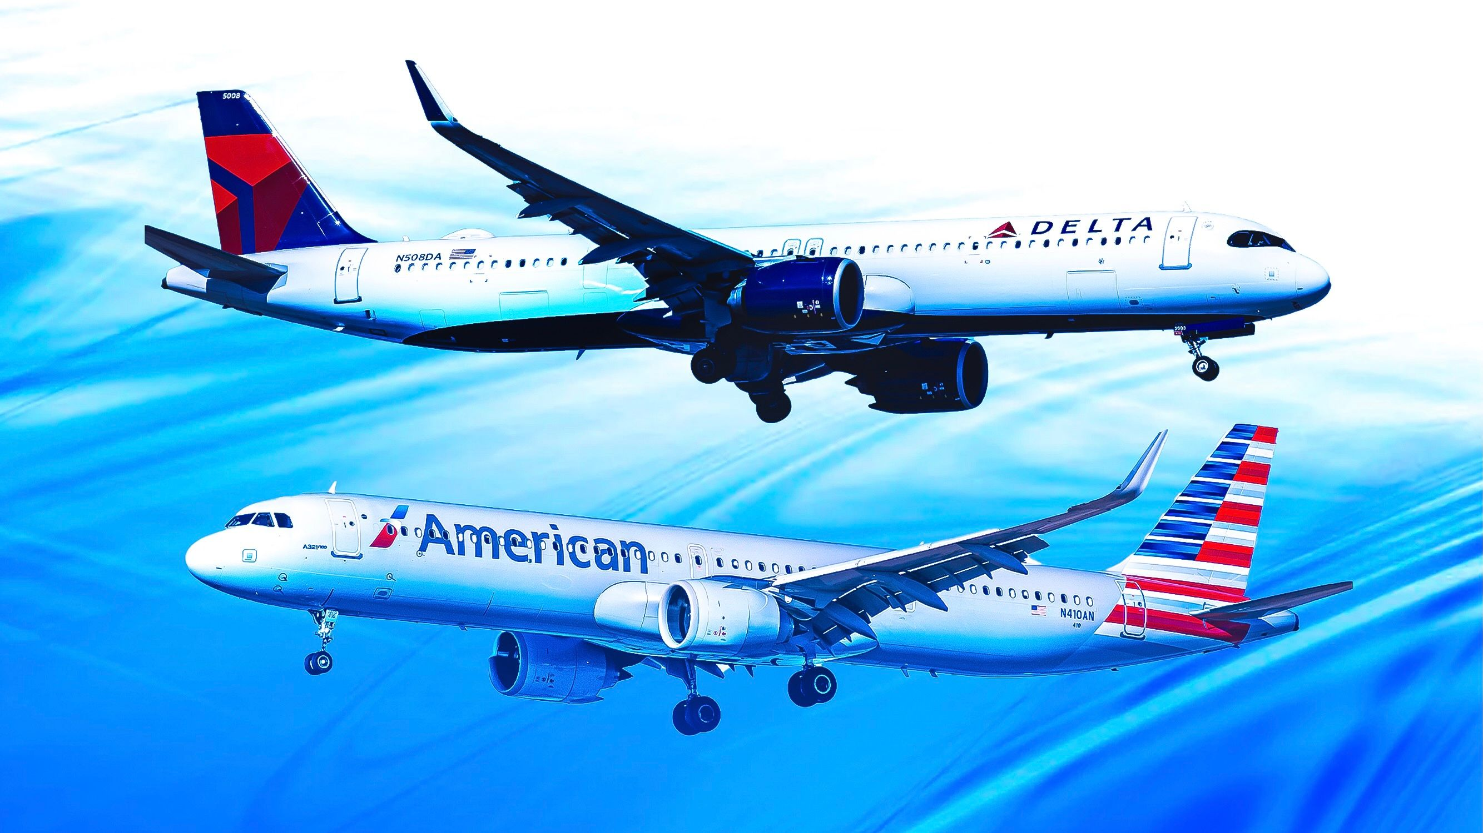
Comparative Catering Strategies: Enhancing Passenger Experience at Delta and American Airlines
By: Skylar Schmidt, Pothu Swetha,
Shwetha Lokeshkumar,
Vaibhavi Shastri, Reilly Bronson

Slide 2
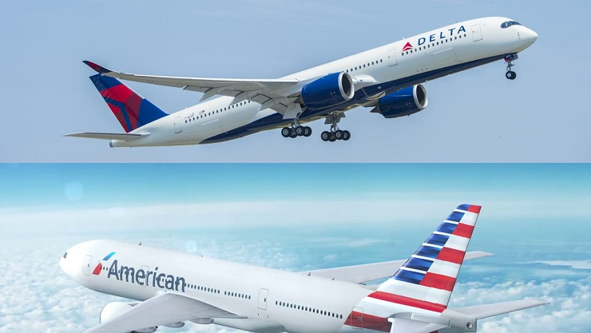
Market Research Problem
How do Delta and American Airlines' in-flight catering and service compare, and what improvements can enhance passenger satisfaction, thereby increasing loyalty and profitability?

Slide 3

Research Questions
What are the current levels of passenger satisfaction with Delta and American Airlines' in-flight food offerings?
How do dietary accommodations influence passenger satisfaction with Delta and American Airlines?
What specific aspects of customer service during mealtimes are most impactful on passengers' overall flight experience with Delta and American Airlines?

Slide 4
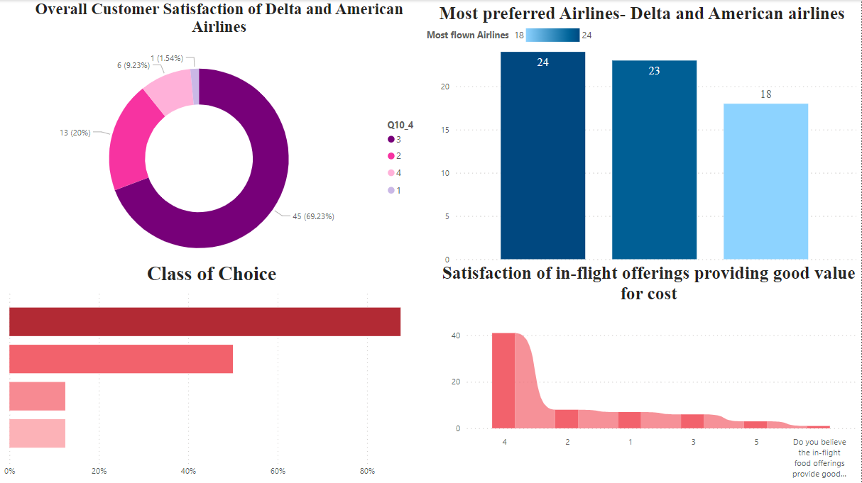

Slide 5
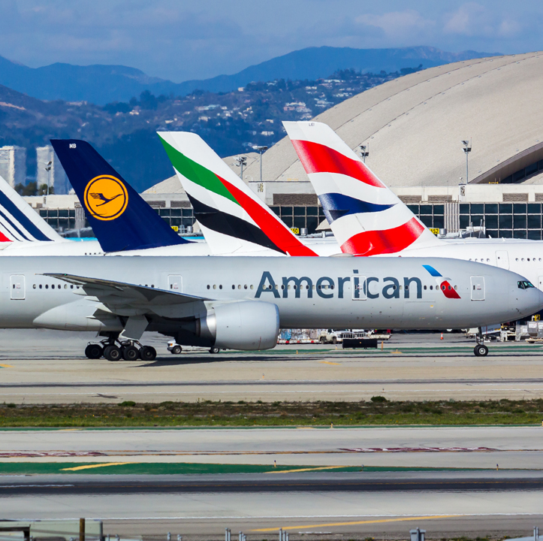
Hypothesis 1
H0: There is no significant difference in the distribution of overall dietary preferences (gluten-free & healthy) between passengers flying Delta and American Airlines.
​
H1: There is a significant difference in the distribution of overall dietary preferences (gluten-free & healthy) between passengers flying Delta and American Airlines.

Slide 6

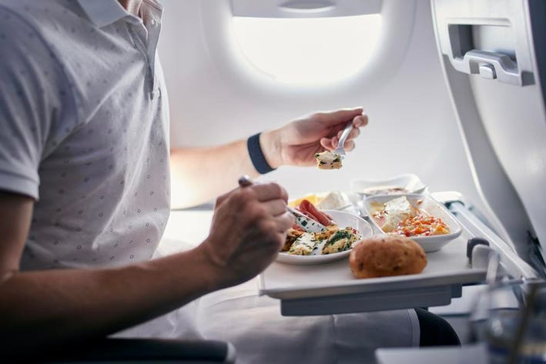
Justification
Our aim is to identify significant variations in overall dietary meal preferences (prefer gluten free and/or prefer healthy ) between Delta and American Airlines. Insights will help better tailor airline meal services to their respective customer bases.
Prediction: Dietary preferences will be similar for comparative airlines
Test & Results
Test Used: Chi-Square
Evaluate Binary Categorical Distribution
Results:
P-Value: 0.61 > 0.05
Chi-Square Stat: 1.85 < 16.92
Conclusion: Do Not Reject Null Hypothesis

Slide 7
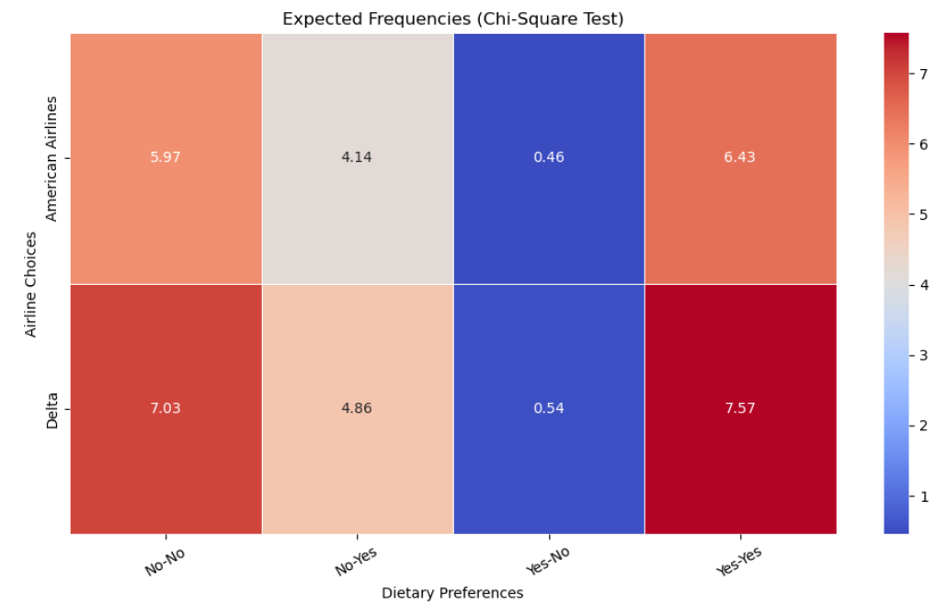

Slide 8
Hypothesis 2
H0: There is no significant difference in satisfaction with in-flight food offerings between Delta and American Airlines passengers.
​
H1: There is a significant difference in satisfaction with in-flight food offerings between Delta and American Airlines passengers.

Slide 9
Why T-test?
To analyze the difference in satisfaction levels between two independent groups: Delta and American Airlines passengers.
A T-test is appropriate when comparing the means of a continuous outcome variable (in-flight food satisfaction) across two independent groups (airlines).
Survey Question - How satisfied were you with the in-flight food offerings on your most recent flight?
 | F | Sig. | t | df | Sig. One-Sided p | Sig. Two-Sided p
Equal Variances assumed | 0.005 | 0.943 | 0.359 | 39 | 0.361 | 0.721
Equal Variances not assumed |  |  | 0.363 | 37.972 | 0.359 | 0.719
Table: Independent Sample T-tests

Slide 10
Test Results
Levene’s Test for Equality of Variances: F = 0.005, p = 0.943.
The p-value greater than Alpha(0.05) indicates we fail to reject Null Hypotheses. Hence, The variance in satisfaction scores is similar across the two groups.
T-Test for Equal of Means: t = 0.359, p = 0.721 (two-tailed).
The p-value greater than Alpha(0.05) indicates we fail to reject Null Hypotheses, indicating no statistically significant difference scores between the groups(Delta and American)
“Based on the sample surveyed, we conclude that passengers of both airlines report similar satisfaction levels regarding their in-flight food experience”
Notes:
Levene’s test the Sig value = 0.943 < Alpha -> Reject the null Hypotheses

Slide 11
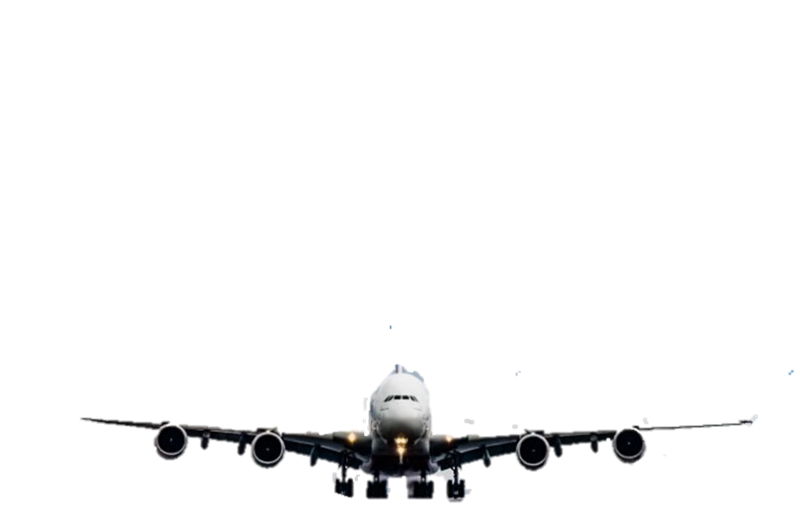
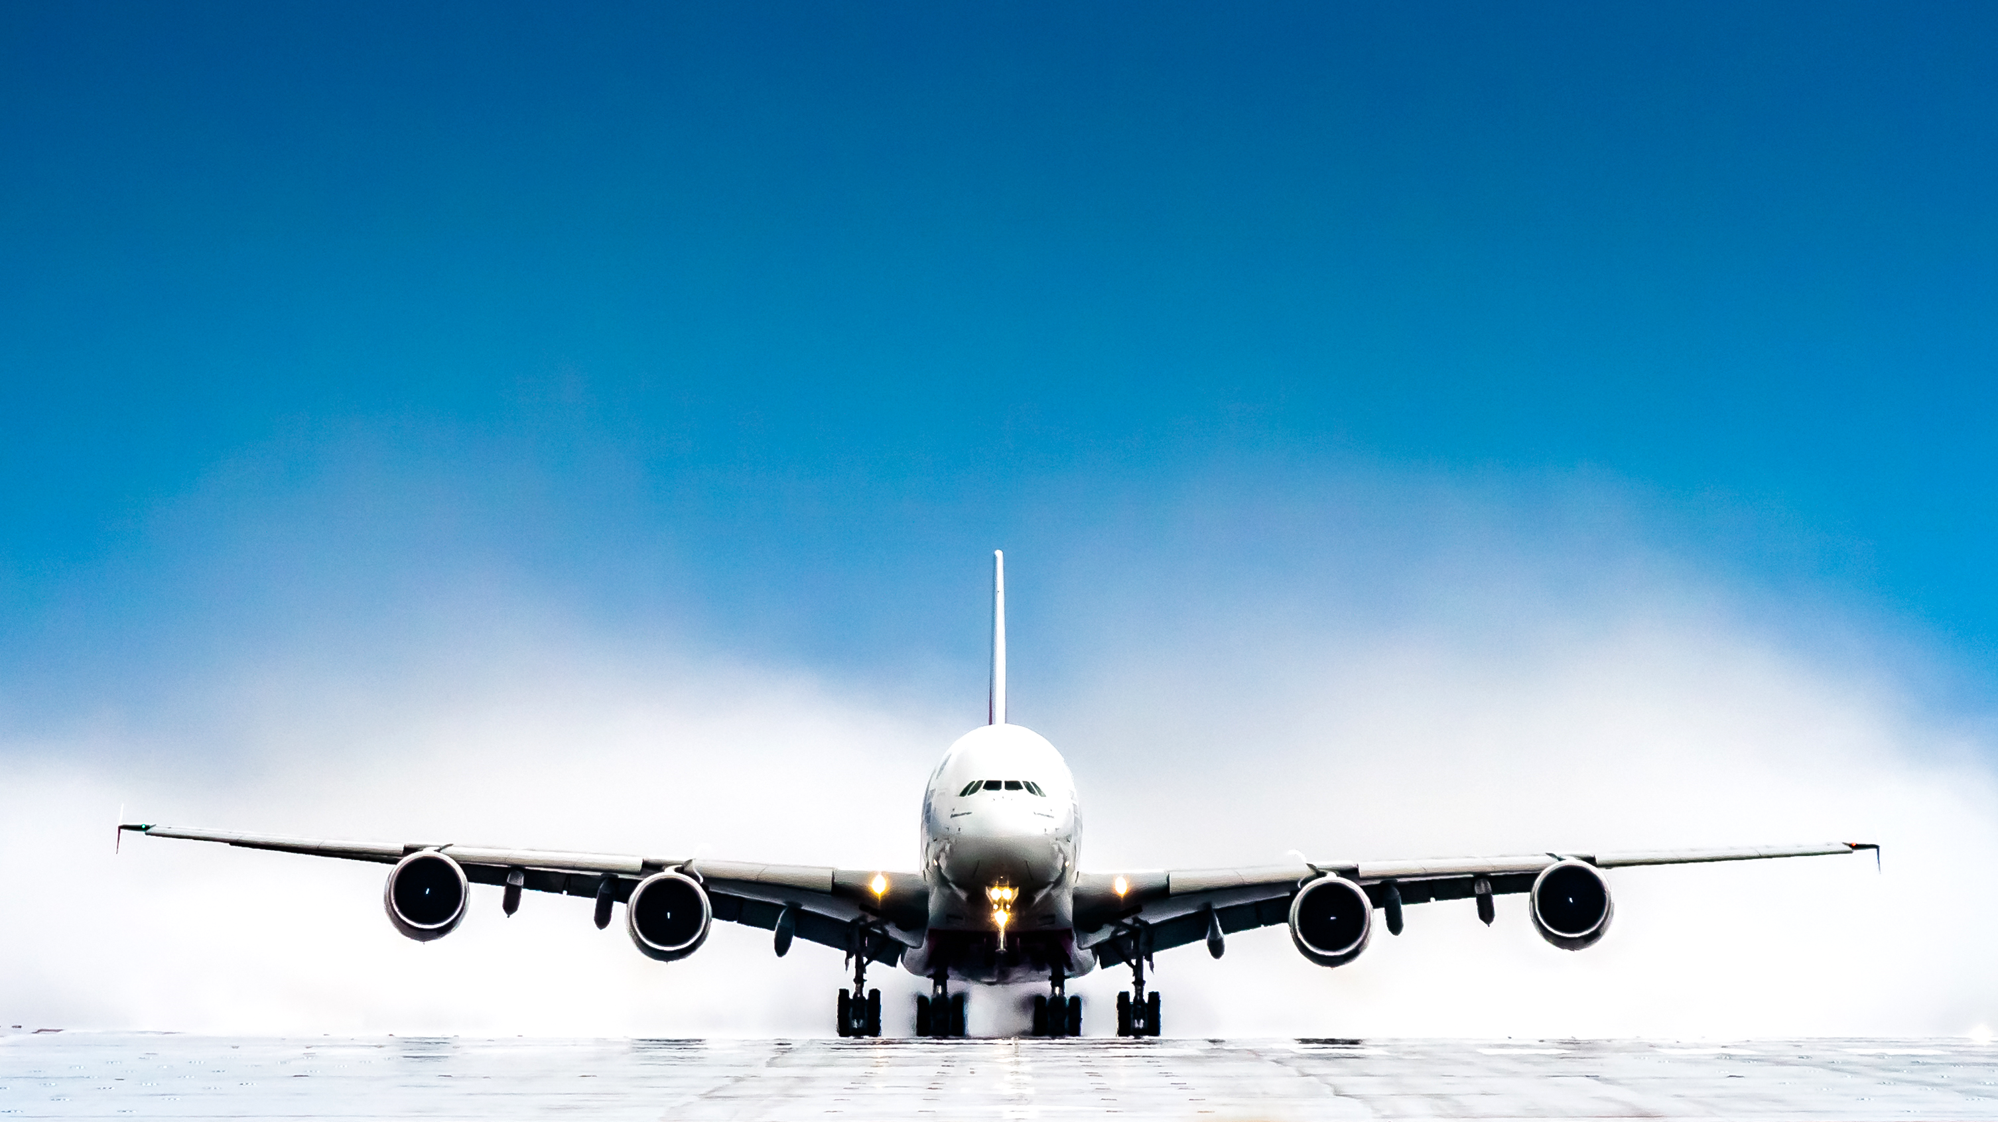
Hypothesis : 3
H0: No significant difference between Delta & American Airlines in passenger preferences for exclusively gluten-free snacks (beyond gluten-intolerant passengers).
H1: Significant difference between Delta & American Airlines in enhancing broader passenger preferences with exclusively gluten-free snacks.

Slide 12

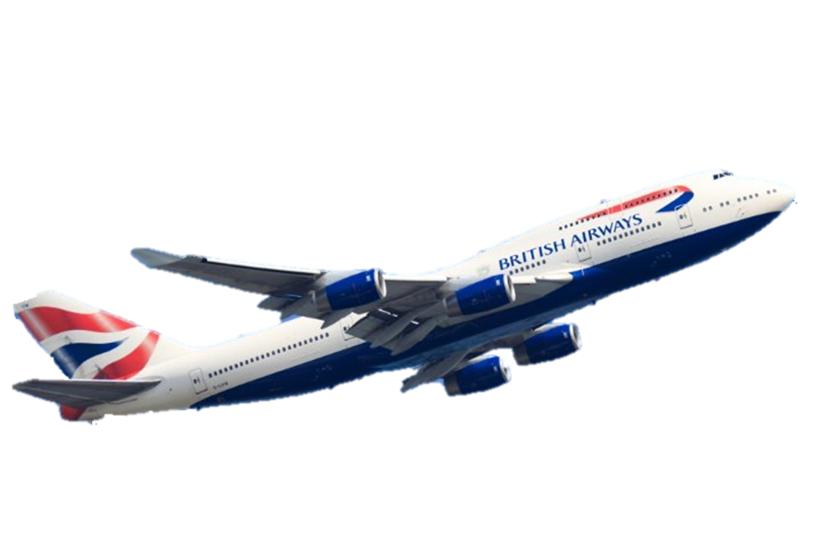
Purpose: To assess the impact of providing gluten-free snack options on passenger preferences between Delta and American Airlines.
Test Used: Analysis of Variance (ANOVA)
Results: The ANOVA results show a statistically significant effect of providing exclusively gluten-free snacks on passenger preferences between Delta and American Airlines.
P-Value: 0.003 (less than the 0.05 significance level)
Stat: F = 9.346, partial eta squared = 0.129 (moderate to large effect size)
Conclusion: Hence, we reject the Null hypothesis

Slide 13
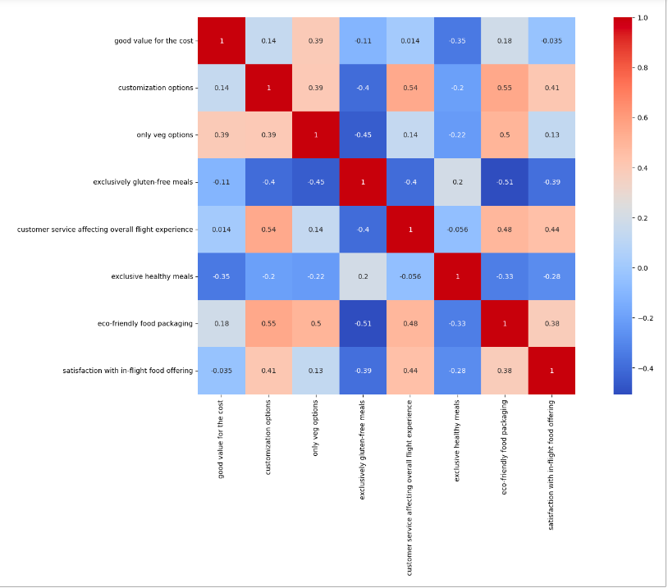
Correlation Matrix

Slide 14
Hypothesis 4
Null hypothesis (H0): There is no correlation between satisfaction with in-flight food offering of passengers and customization, gluten-free and vegetarian meals offered.
Alternative hypothesis (Ha): There is at least one statistically significant correlation between satisfaction with in-flight food offering and customization, gluten-free and vegetarian meals offered.

Slide 15
OLS Regression
Survey Question - How satisfied were you with the in-flight food offerings based on various aspects
Various aspects | P-value
Good value for the cost | 0.995
Customization Options | 0.313
Only Veg Options | 0.321
Exclusively Gluten-free meals | 0.015
Exclusively healthy meals | 0.864

Slide 16
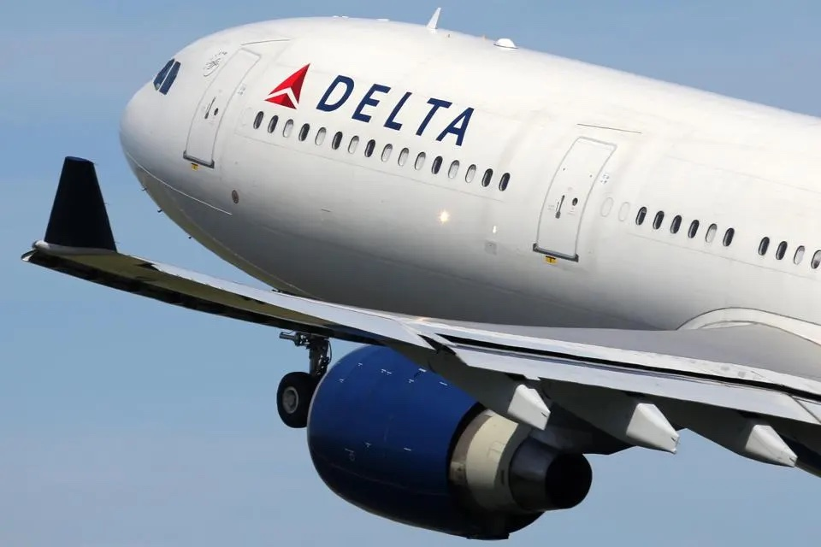

Managerial Recommendations
National airline food trends suggest consistent passenger preferences among comparable airlines (i.e., Delta & American Airlines)
Focus more on general industry trends versus individual airline trends
Investment in other Areas of the Customer Experience
Continuous Improvement and Innovation in Food Services
Expand and actively promote gluten-free snack options by partnering with manufacturers, employee's marketing gluten-free options, and regularly assessing passenger feedback
Notes:
Investment in Other Areas of the Customer Experience: Since in-flight food satisfaction does not appear to differentiate Delta from American Airlines, it may be more strategic to allocate resources towards other aspects of the customer experience that can serve as differentiators. This could include cabin comfort, entertainment options, customer service, or loyalty programs. These areas might offer a better return on investment in terms of enhancing customer satisfaction and loyalty.
Continuous Improvement and Innovation in Food Services: While current satisfaction levels are similar between the airlines, it’s important not to become complacent. Management should focus on continuous improvement and innovation within in-flight food services to exceed passenger expectations. Regularly updating the menu, accommodating dietary restrictions, and ensuring the freshness and quality of meals can contribute to a superior customer experience that may become significant over time.

Slide 17

Thank You !
Notes:
Levene’s test the Sig value = 0.943 < Alpha -> Reject the null Hypotheses

